Slide 1

Basic Details of the Team and Problem Statement
Ministry of Social Justice and Empowerment
Organization Name: Department of Empowerment of Persons with Disabilities(Divyangjan)
PS Code: RK777
Problem Statement Title: Development of Software for AAC for persons with different disabilities
Team Name: Tylam visions
Team Leader Name: Yogarajan J
Institute Code (AISHE): C-16477
Institute Name: Loyola-ICAM College of Engineering and Technology.
Theme Name: MedTech/BioTech/HealthTech

Slide 2
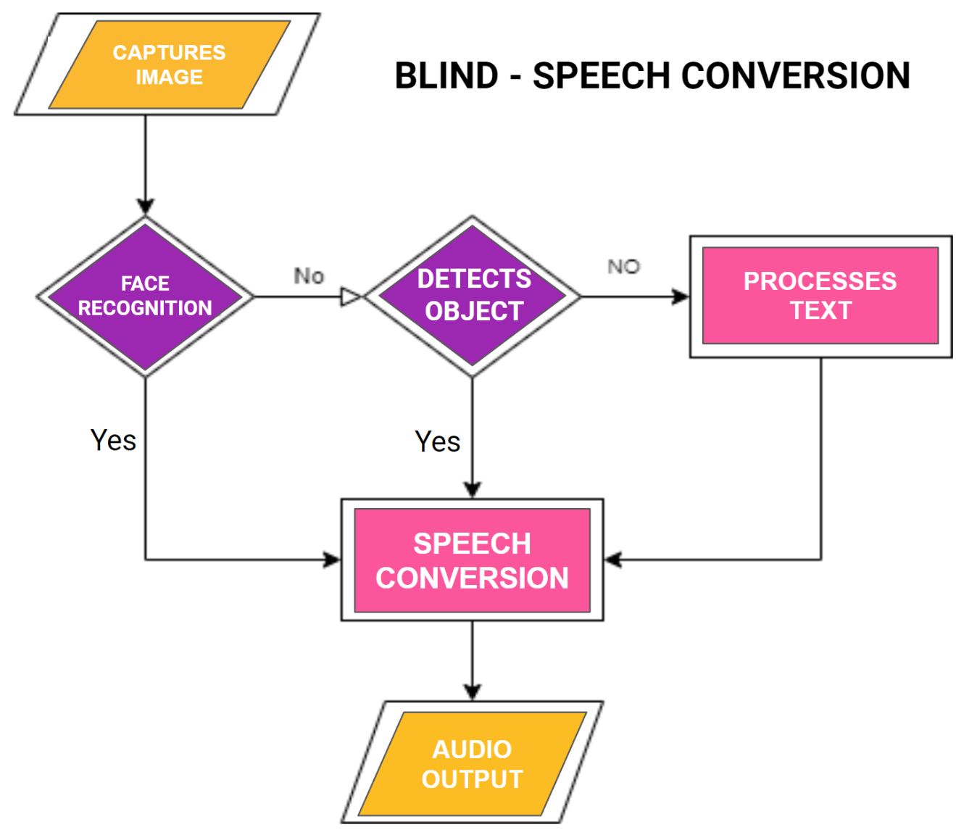
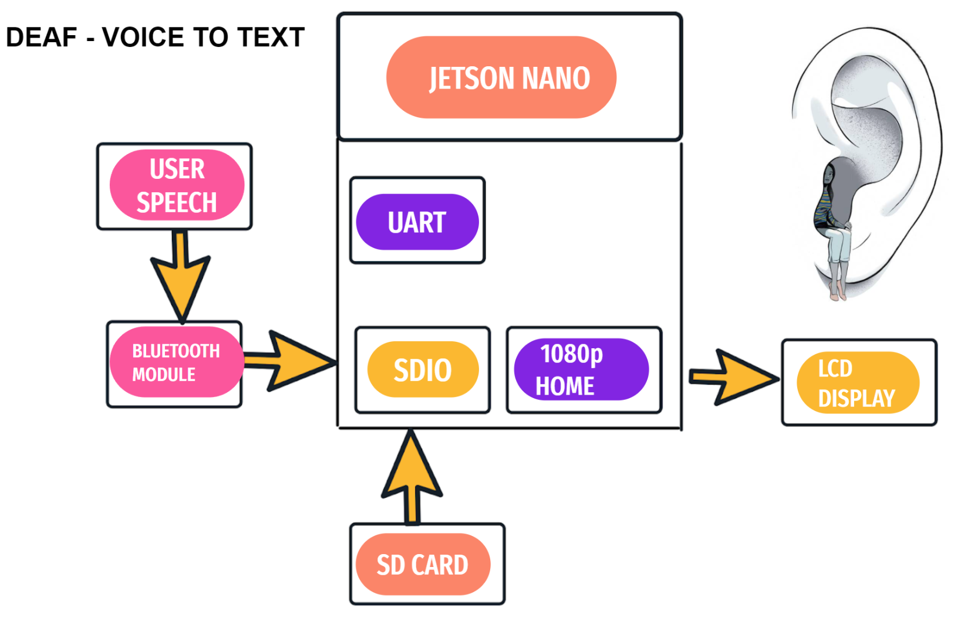
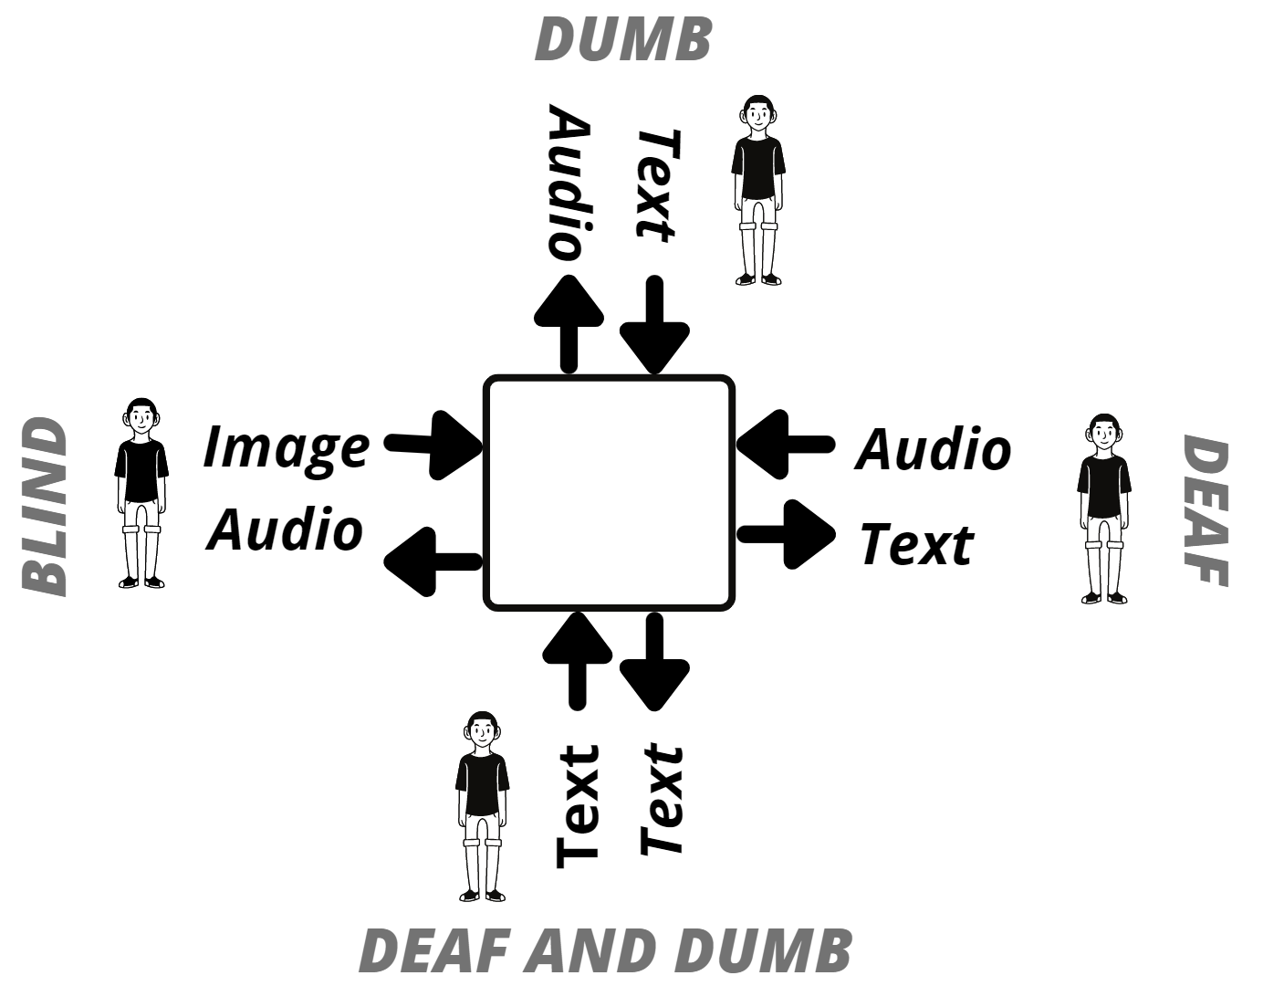
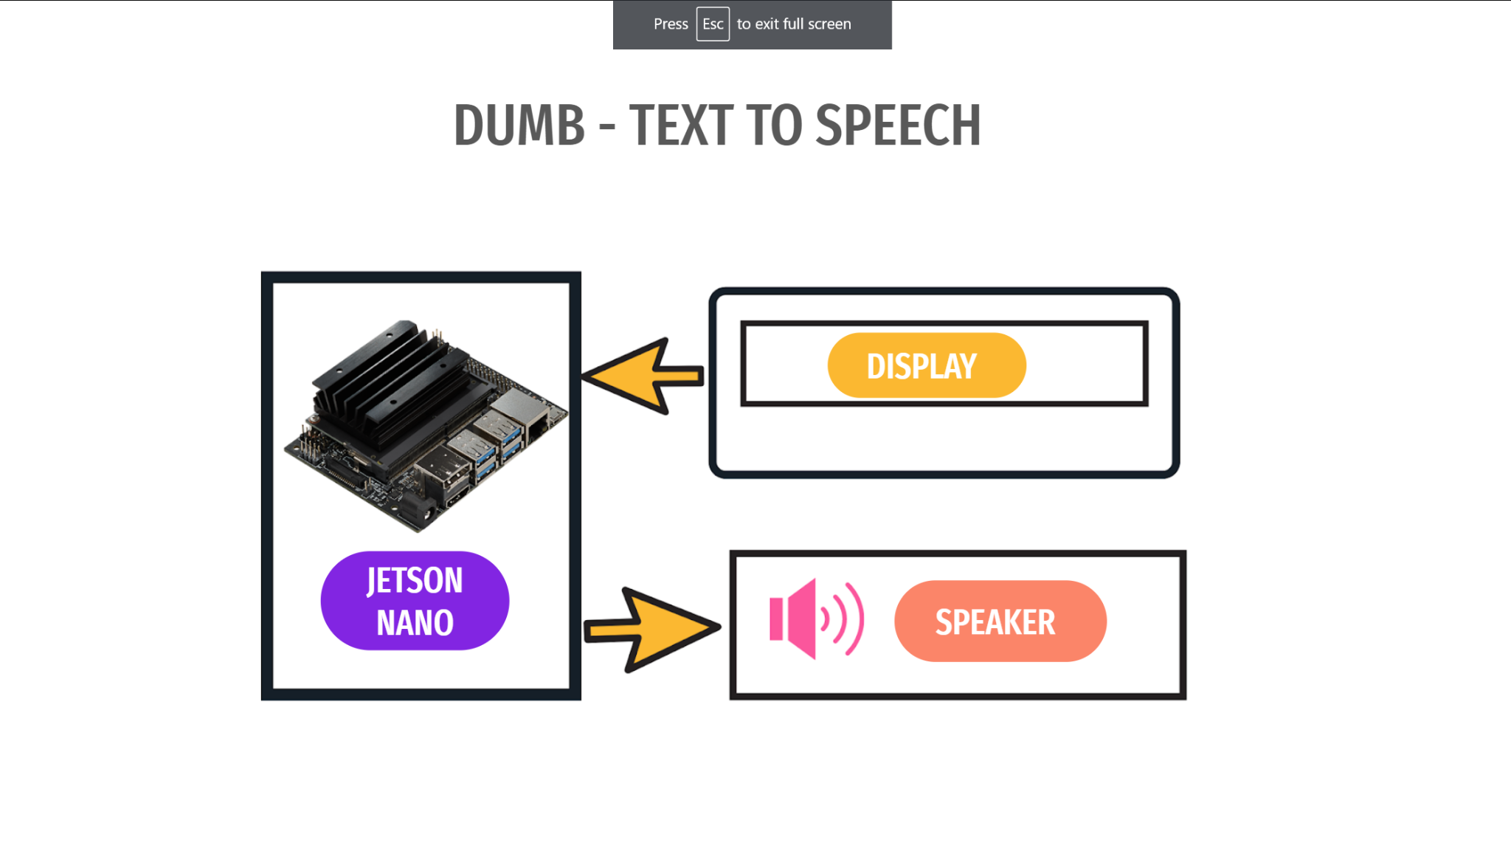
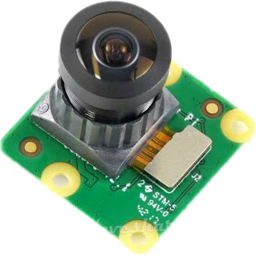


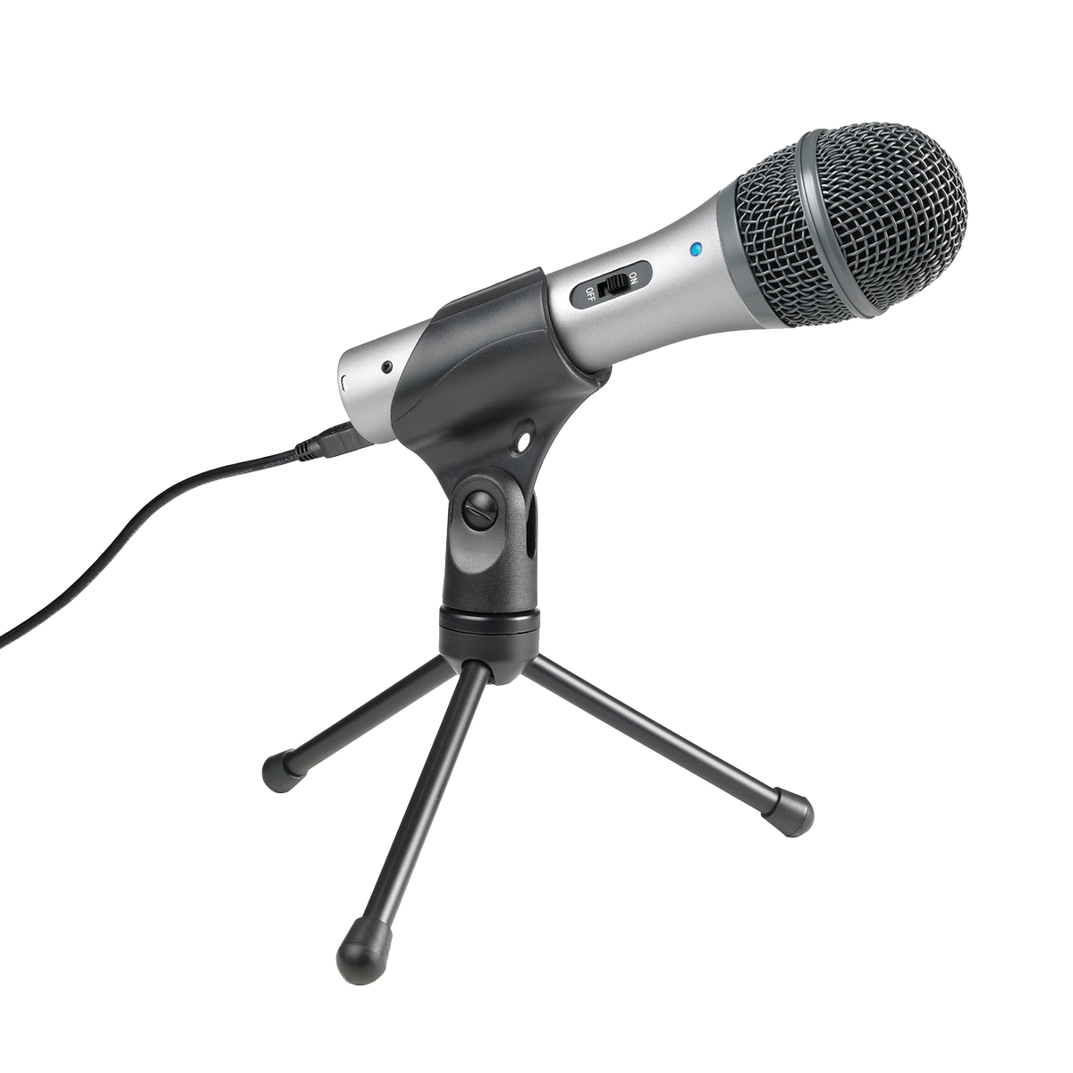
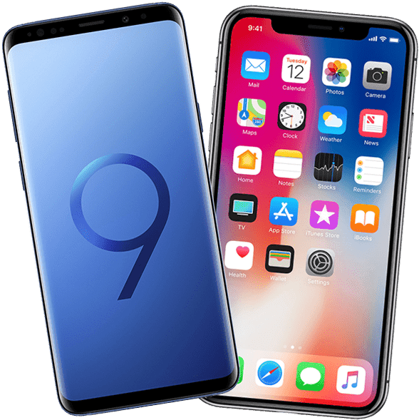

Idea Details:
WORK FLOW
IDEA OR SOLUTION
DISPLAY
TYLAM
VISIONS
TECHNOLOGY STACK
CAMERA
HEADSET
JETSON NANO
MOBILE
MIC
PYTHON

Slide 3
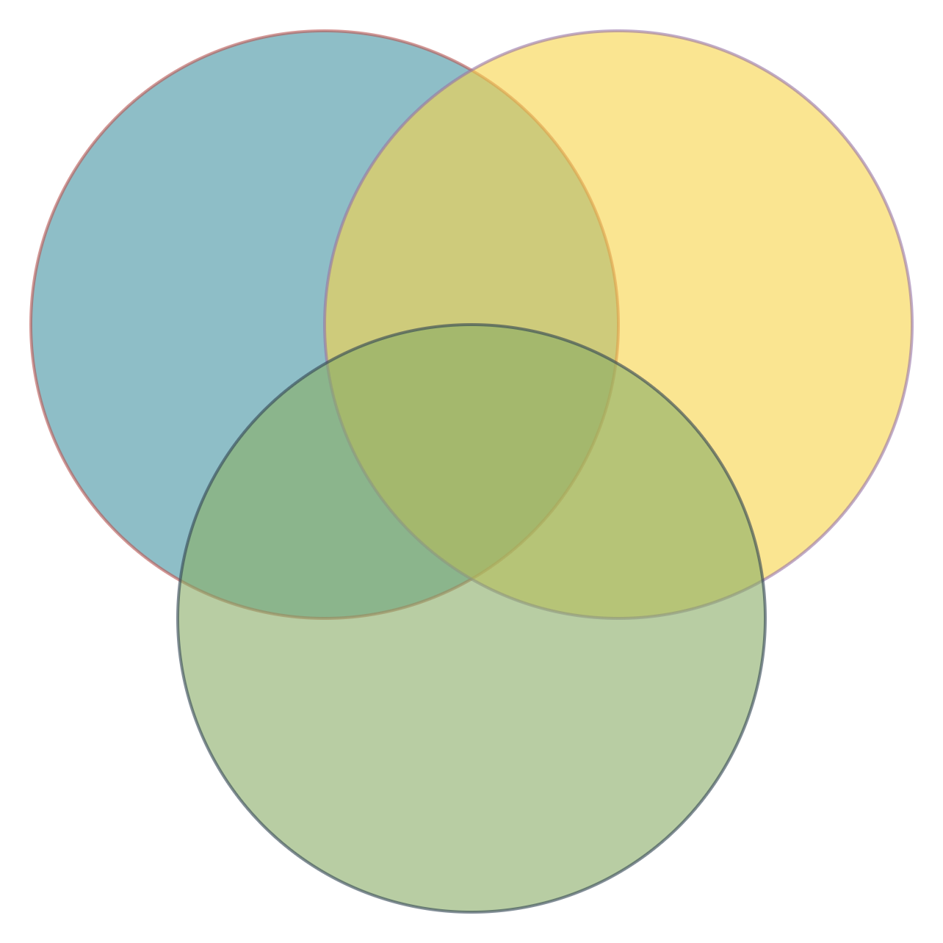
Idea/Approach Details
Blind
Deaf
Use Cases:
285million people are visually impaired.
Helps blind to recognise/detect faces and objects/texts.
Helps deaf to receive text of the input audio.
Converts text into audio output in order to help dumb people.
Over 5 percentage of the world’s population i.e.430 million people are deaf.
97.6 million
39 million are completely blind.
Dependencies
34 million
9 million
https://youtu.be/VX3HgsmD3CU
Mute
*Kindly watch our video.This is the prototype of our product designed for blind. Similarly, it is done for deaf and dumb.
Approximately 70 million of the people are mute.

Slide 4
Team Member Details
Team Leader Name : YOGARAJAN J
B.E ECE 1st Year
Team Member 1 Name: ABISHEK MERVIN J
B.E ECE 1st Year
Team Member 2 Name: ASHIKA MARIYA R
B.E ECE 1st Year
Team Member 3 Name: MAHIZHAN A
B.E ECE 1st Year
Team Member 4 Name: LEO WILLIAM G
B.E CSE 1st Year
Team Member 5 Name: TARUN V SHEKAR
B.E ECE 1st Year
Team Mentor 1 Name: MR. MAHIMAI DON BOSCO FP
Category: ACADEMIC Expertise: Embedded system and IOT Domain Experience: 12 years
Team Mentor 2 Name: DR. ANITHA JULIETTE
Category: ACADEMIC Expertise: Electronic System Design and VLSI design Domain Experience: 14 years

